Slide 1
Dietary Supplement Search Engine
Renee Tso & Peter Kuimelis

Slide 2
What are dietary supplements?
Classified as “food” by the Dietary Supplement Health and Education Act (DSHEA) of 1994
FDA is not authorized to review dietary supplement products for safety and effectiveness
Consumers must educate themselves

Slide 3
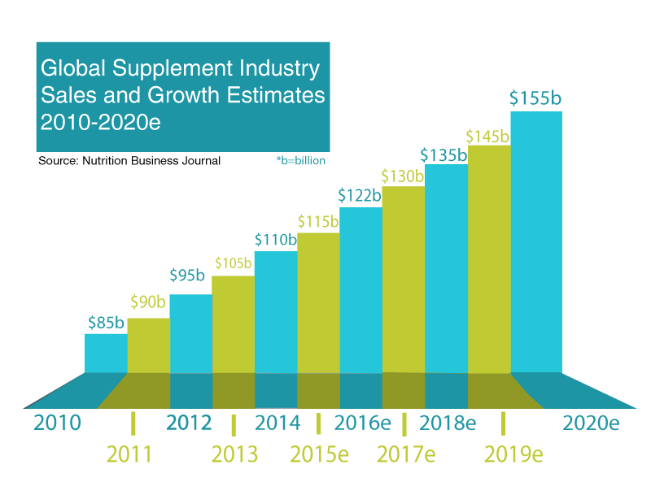
Sales of dietary supplements

Slide 4
Issues with existing regulations
Millions of people use dietary supplements to self-treat health conditions without doing proper research into their effects
Consumers are responsible for evaluating and choosing which supplements to use
Internet is a jungle of marketing hype and misinformation

Slide 5
Formulating the problem

